Slide 1




Welcome
Computer Science

Slide 2
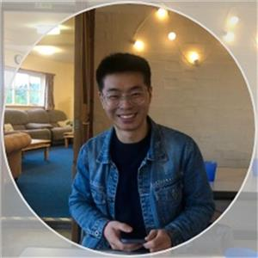
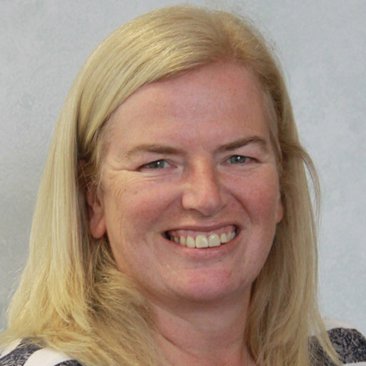
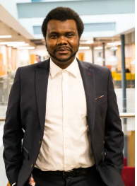
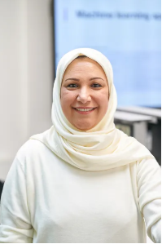
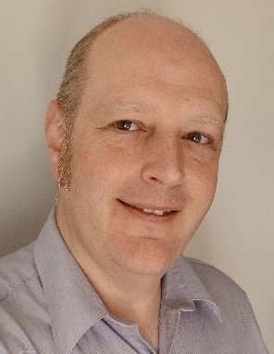
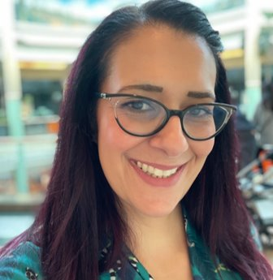
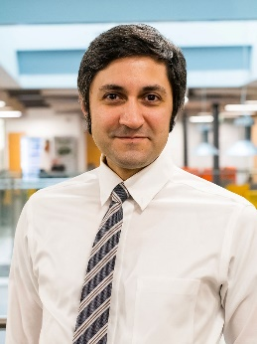
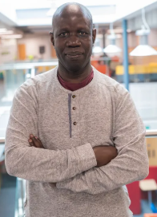
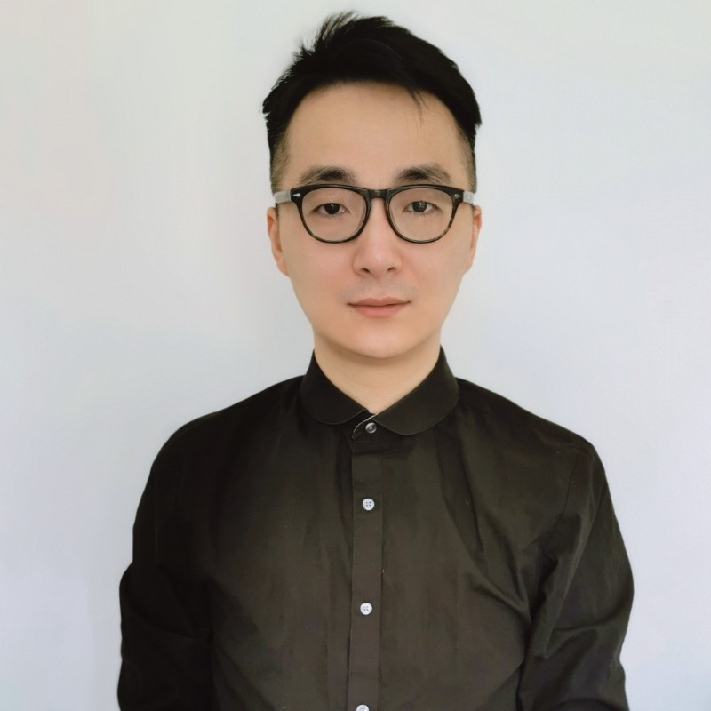
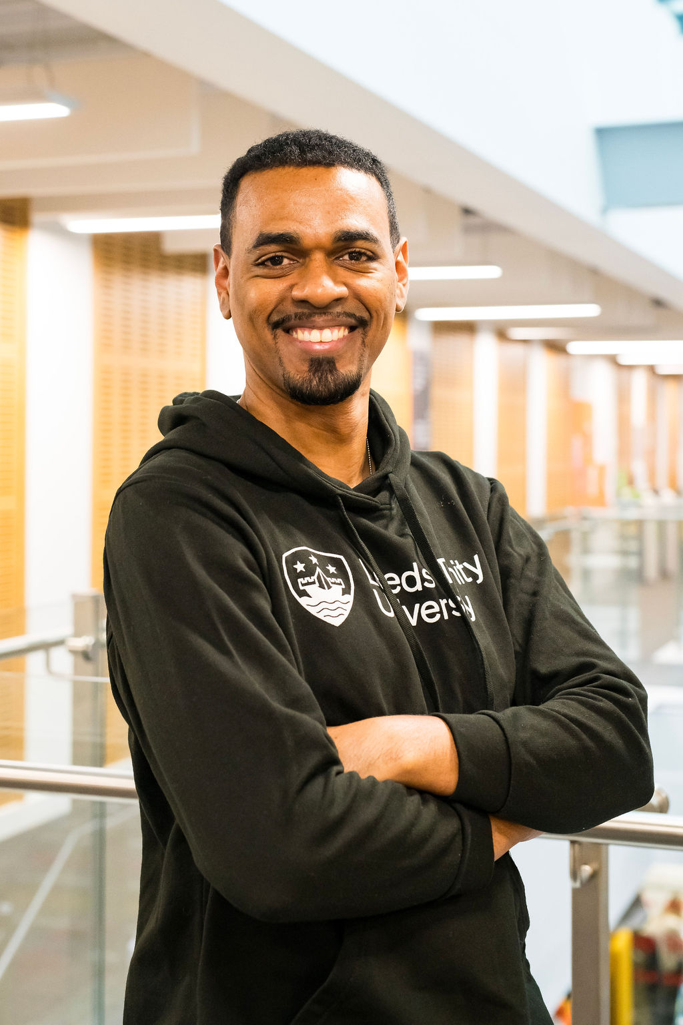
Our Computer Science team
Dr Hua Yan
Dr Lesley May​
Dr Aliyu Lawal Aliyu
Dr Antesar Shabut
Dr Nick Mitchell
Dr Nicky Danino​
Dr Yashar Baradaranshokouhi
Jim Diockou
Dr Xin Lu
Ravi Soleyn

Slide 3

Our Computer Science Courses
BSc (Hons) Computer Science
BSc (Hons) Computer Science with Cyber Security
BSc (Hons) Computer Science with Games Development
Foundation Year available

Slide 4

Why Study Computer Science?
Computer Science is ubiquitous (it’s everywhere!)
Expertise in Computer Science will help you solve complex problems
Computer Science skills empower you to have a positive impact on the world
Computer Science can open doors to a range of lucrative and rewarding careers – currently driving the bulk of recruitment
Computer Science skills are beneficial in the job market, even if you decide to change careers
Computer Science offers opportunities for innovation and creativity
Notes:
This is your chance to explain some of the reasons why our students love studying with us and the kind of community we have here at Leeds Trinity University – we’ve pulled out some key USPs here that give you the chance to explain what differentiates our Computing course from other universities.
For placements, please focus on what makes them different – with every course (not a sandwich year), extensive support, industry partnerships etc…
Explain the benefits of the BCS accreditation
Give example of Liam

Slide 5

Why Study Computer Science at Leeds Trinity University?
Professional work placements and live employer projects
Research and industry-led teaching
Academics with a wide range of expertise
Courses designed to apply theory in practical learning environments
Links with tech companies in and around Leeds (and further afield)
Class sizes offering excellent levels of personal support
24/7 remote access to computing labs and to professional tools, resources and guidelines
Notes:
This is your chance to explain some of the reasons why our students love studying with us and the kind of community we have here at Leeds Trinity University – we’ve pulled out some key USPs here that give you the chance to explain what differentiates our Computing course from other universities.
For placements, please focus on what makes them different – with every course (not a sandwich year), extensive support, industry partnerships etc…
Explain the benefits of the BCS accreditation
Give example of Liam

Slide 6
Where could your degree take you?​
You’ll graduate ready for the vast range of opportunities ​in the thriving tech and digital sectors, such as:​
Scrum master
AI developer
UX/UI designer
UI web software engineer
Cyber security analyst
Agile project owner
DevOps engineer
Software developer/engineer
Games developer
Software tester
Notes:
This is your opportunity to talk about the vast array of careers that a Computer Science degree could lead to.
Explain some of these jobs, what range of skills do applicants need and how students will develop these skills in the programme?
When discussing earnings be sure to clarify level of experience and manage expectations around entry level earnings.
Salary: Scrum Master (October, 2022) | Glassdoor -
Possible Q&A:
Q: How much experience (years) do you need to they need to get this average?
A: It starts with salaries around 41K, and in average you will be paid 57K a year, As you gain more experience, you can expect your salary to increase.
Q: which area? is it London or the North?
A: It is across the UK
We can’t add the graph into here as can’t paste pictures in to notes, so the infomration is:
Earning potential as a Scrum master - you may need to spend some years working as a software developer to build your skills and experience first.
Low – 41k
Average – 57 K

Slide 7

Progression Routes at Leeds Trinity University
MSc Data Science and Artificial Intelligence
MSc Computer Science (subject to validation)
PhD Research

Slide 8
Python Activity
QR CODE
FAKE LIBRARY
SHORT-URL

Slide 9
Hands-on Programming
We will cover this in three videos:
Setting up the programming environment
We will use Replit online platform (replit.com)
Introduction to the Turtle package
Design and implementation of two games
Turtle competition (Whoever's turtle passes the finish line first will win)
Rolling dice (player with the highest/lowest number is the winner) THE ROAD TO EL DORADO Clip - "Dice" (2000) - YouTube

Slide 10

ACTIVITIES
Video 1: Anaconda and Jupyter Notebook Installation
Video 2: Intro to Turtle package
Video 3: Implement two games
https://bit.ly/csltusfd

Slide 11

Final Task
Think about fairness of the turtle competition.
Use random methods from the dice rolling example to make the competition random to be fair on both competitors.
Hints:
Listen to the points at the end of the third video (Designing and implementing games)
You may want to use other methods from the random package such as choice ($random.choice$)

Slide 12
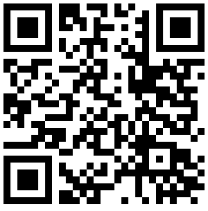
Got a question? Chat with our students and staff through Unibuddy or submit your questions and we'll forward it to our expert teams.
Notes:
Merge 30 and 31.

Slide 13
Thank you
Dr Yashar Baradaranshokouhi
Yash.B@leedstrinity.ac.uk
Dr Nick Mitchell
N.Mitchell@leedstrinity.ac.uk

